Slide 1
Mortality Rates Smoothing Using Mixture Function
統碩一 賴東圻
Jan 8 2024

Slide 2
Content
1.Introduction
2.Mixture Function
3.Mortality Rate Smoothing
4.Smoothing Using Moving Mixture Function
5.Impact of Mortality Rates Smoothing
6.Conclusion

Slide 3
Introduction
Samuel Hudec and Jana Spirkov´a (2018)
New mortality rate smoothing method

Slide 4
Mixture function
Aggregation function
Standard monotonicity

Slide 5
Mixture function

Slide 6
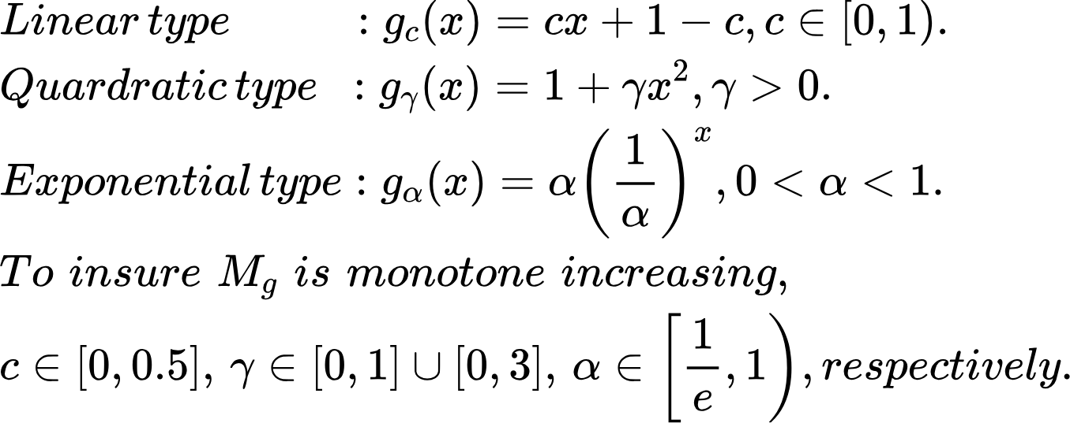
Mixture function

Slide 7
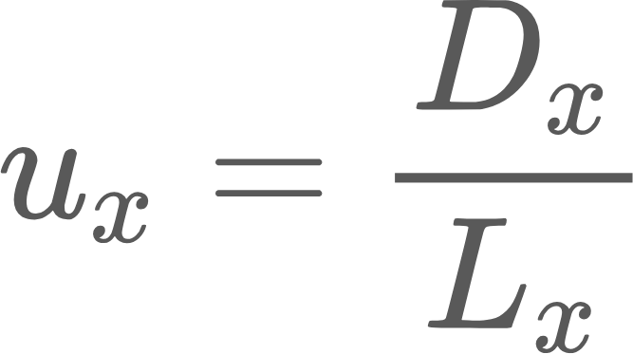
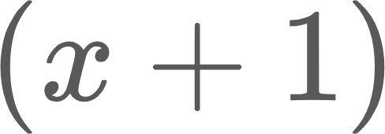
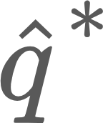
Mortality Rates Smoothing
Define is the real numbers live in age ,and is the death number at age .
, means the probability that a person at age x will die within a small time interval.
,the probability that a person at age x will die before age .
Use moving weighted average to define with n=3,
Use other interpolation of the second degree method for higher age smoothing such as Gompertz-Makeham’s Formula.

Slide 8
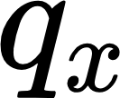
Smoothing Using Moving Mixture Function
Calculate where .
.
Over age 80, use Gompertz-Makeham’s formula.
, and find out the intersection with moving mixture
functions.

Slide 9
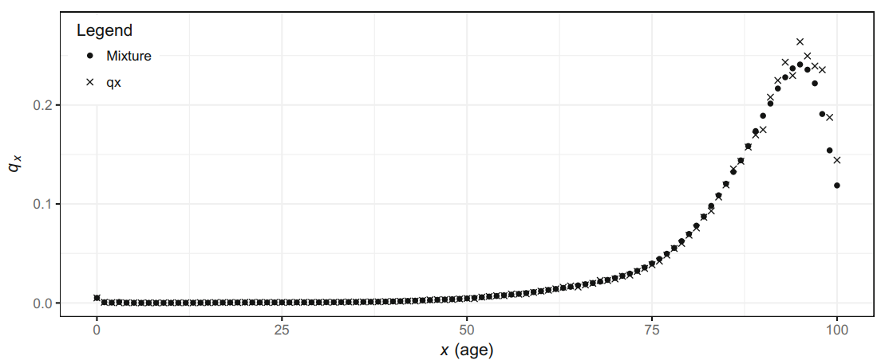
Hudec, S., Špirková, J.(2018), fig.1

Slide 10
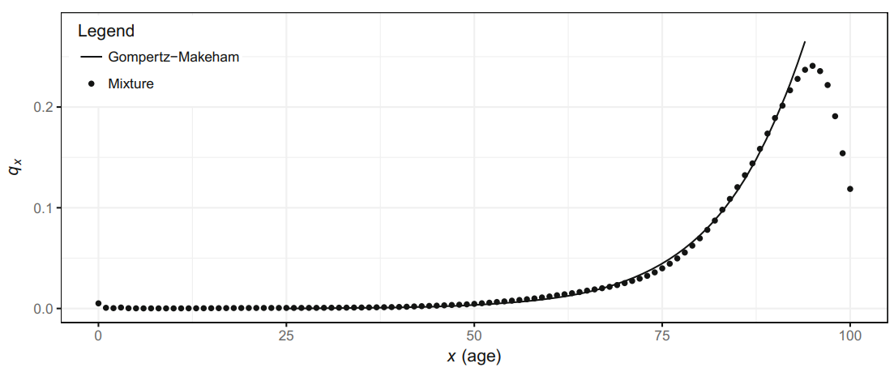
Hudec, S., Špirková, J.(2018), fig.1

Slide 11
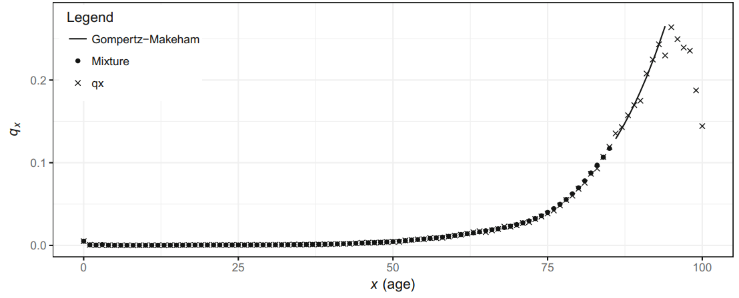
Hudec, S., Špirková, J.(2018), fig.1

Slide 12
Model selection
Use MSE to select the most suitable moving mixture function.
For linear mixture function,
By the same way, using quadratic and exponential functions to calculate their MSE.

Slide 13
Model selection
By bias-variance trade-off, we choose the mid point of each interval as the ‘’best’’ coefficient.
Hudec, S., Špirková, J.(2018), fig.3

Slide 14
Conclusion
It’s suitable and easy to use in any years.
We can choose the most appropriate model for the mortality rate by the weighting factors behavior.

Slide 15
Reference
Hudec, S., Špirková, J.(2018), Mortality Rates Smoothing Using Mixture Function,Information Processing and Management of Uncertainty in Knowledge-Based Systems. Theory and Foundations. IPMU 2018. Communications in Computer and Information Science, vol. 853,pp.140-150. Springer, Cham.
https://doi.org/10.1007/978-3-319-91473-2_12

Slide 16
Thank you for your listening
統碩一 賴東圻
Jan 8 2024

